Slide 1
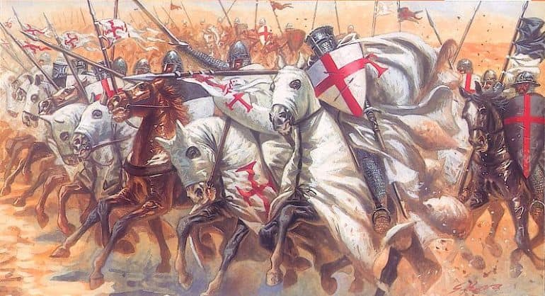
The Knights Templar
By- Malvika Pandey
XI-D

Slide 2
Introduction
The Poor Fellow-Soldiers of Christ and the Temple of Solomon were founded in Jerusalem in 1119.
They were “holy-soldiers” who worked to protect the Holy Land as well as pilgrims visiting the holy-shrines.
Soon became a formidable organisation with a vast following, wealth, fame and influence.

Slide 3
Brief History
Founded by Hugh de Payens in 1119 during the First Crusade.
They were lent support by King Baldwin II and endorsed by the powerful French abbot, Bernard of Clairvaux.
The Order soon gained fame and grew considerably in size.
By 1150, they developed a form of banking and acted as bankers to kings as well as pilgrims.
However, some saw them as cold-blooded murderers. Their power and wealth also attracted a lot of jealousy.

Slide 4
Organization and Conduct
Not all Templars were warriors. They also had servants, Chaplains and Drappiers.
Only men from landed class could become knights, others became sergeants.
At its peak, only a tenth of the Order (about 1,500-2,000) were actually knights.
Their were certain requirements for those wanting to join the Order.
They were known for their strict discipline.

Slide 5
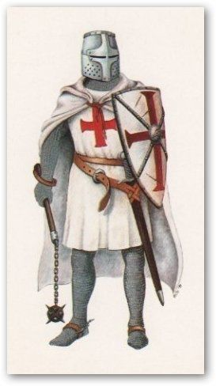
Wartime uniform

Slide 6
Wealth
They amassed huge riches and soon became moneylenders to kings and even the Pope.
As part of the contract for those who banked with them, the money of those who died during the pilgrimage would be claimed by them.
Expanded economic operations through the ownership of mills and vessels.

Slide 7
Cryptography
The Templars were dedicated to secrecy especially after they became involved in trade and banking.
They became masters in the art of cryptography and developed a secret alphabet for their use.
Each symbol of the alphabet is a piece of the Cross of the Order.

Slide 8
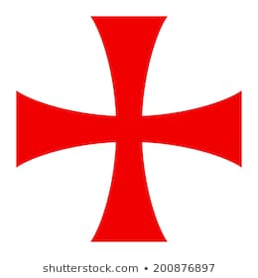
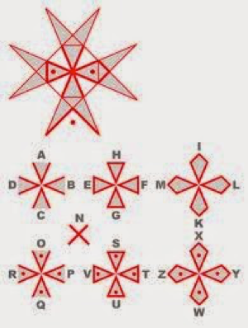
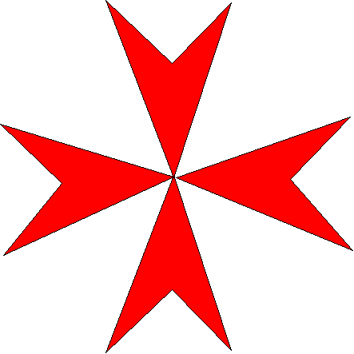
Original Cross
Secret alphabet
Cross when alphabet was developed

Slide 9
Downfall
The Order invited many enemies and rivals and many also saw them as a threat.
They were accused of heresy, immorality, idol worship and homosexuality.
King Phillip IV ordered their arrest on October 13, 1307.He also convinced the Pope to order their suppression and dissolution.
Pope Clement V issued 3 papal bulls against the Templars -“Pastoralis praeeminentiae” (1307)
-“Vox in excelso” (1312)
- “Ad providam” (1312)

Slide 10
Conspiracies
Friday the 13th.
The Holy Grail.
Initiation ceremonies.
Jacques de Molay’s curse.
Still exist today.

Slide 11
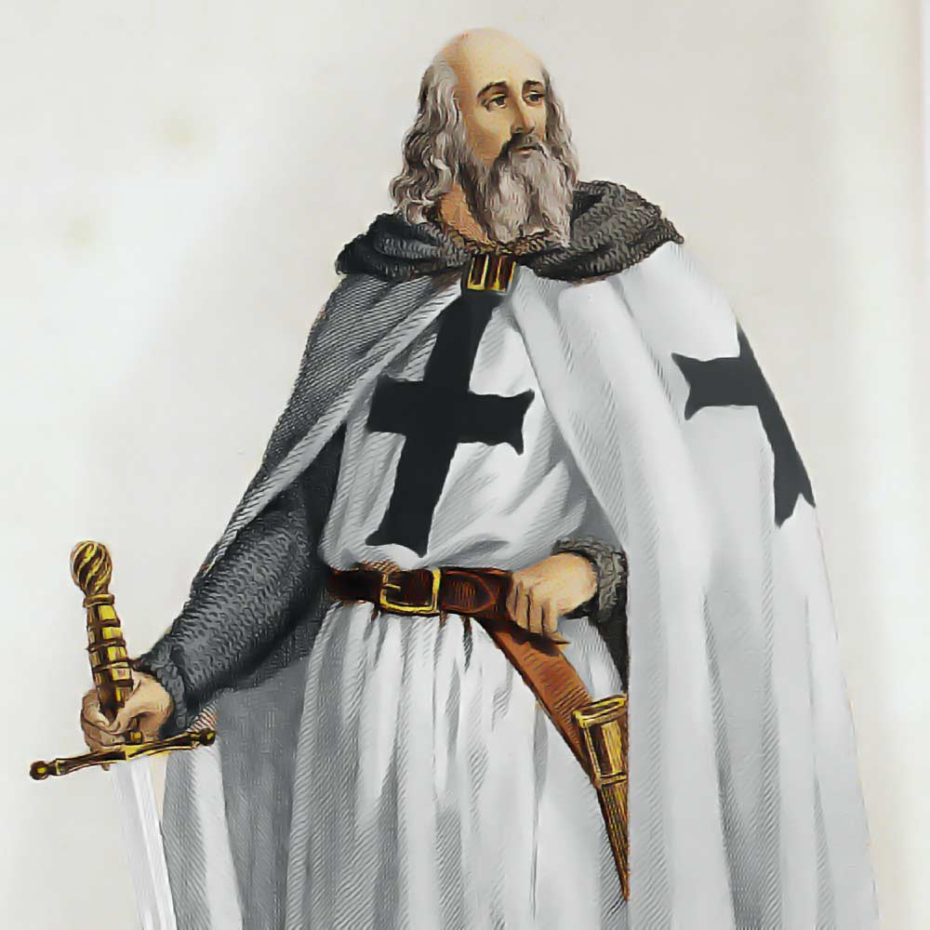
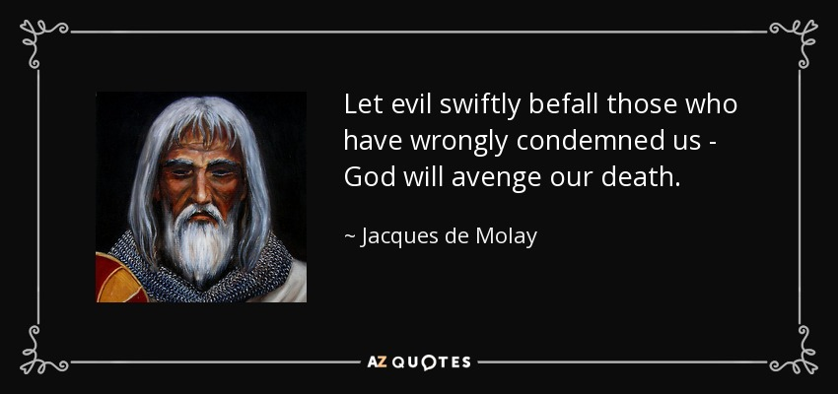
Jacques de Molay’s curse
Jacques de Molay

Slide 12
Conclusion

Slide 13
Thank You

